Slide 1
Data structure and Algorithm​ Lesson 5: Sorting algorithm
Aj. Suttinee

Slide 2
Problem
Sorting is considered to be one of the most fundamental problem in studying algorithms
Input: list e.g. array
Output: the sorted list
34 | 8 | 64 | 51 | 32 | 21 | 1 | 2 | 9 | 10
1 | 2 | 8 | 9 | 10 | 21 | 32 | 34 | 51 | 64

Slide 3
Sorting
Bubble sort
Insertion sort
Selection sort (Home Work)
Shellsort
Mergesort
Quicksort
Bucket sort
Heapsort

Slide 4
Bubble sort
One of the simplest sorting algorithm
Swap the adjacent elements if they are in wrong order
A[0]
A[1]
A[2]
A[3]
A[4]
A[5]
34 | 8 | 64 | 51 | 32 | 21
i=0
8 | 34 | 64 | 51 | 32 | 21
8 | 34 | 64 | 51 | 32 | 21
8 | 34 | 51 | 64 | 32 | 21
8 | 34 | 51 | 32 | 64 | 21
8 | 34 | 51 | 32 | 21 | 64

Slide 5
Bubble sort
A[0]
A[1]
A[2]
A[3]
A[4]
A[5]
i=1
8 | 34 | 51 | 32 | 21 | 64
8 | 34 | 51 | 32 | 21 | 64
8 | 34 | 51 | 32 | 21 | 64
8 | 34 | 32 | 51 | 21 | 64
8 | 34 | 32 | 21 | 51 | 64
i=2
8 | 34 | 32 | 21 | 51 | 64
8 | 34 | 32 | 21 | 51 | 64
8 | 32 | 34 | 21 | 51 | 64
8 | 32 | 21 | 34 | 51 | 64

Slide 6
Bubble sort
A[0]
A[1]
A[2]
A[3]
A[4]
A[5]
i=3
8 | 32 | 21 | 34 | 51 | 64
8 | 21 | 32 | 34 | 51 | 64
8 | 21 | 32 | 34 | 51 | 64
i=4
8 | 21 | 32 | 34 | 51 | 64
8 | 21 | 32 | 34 | 51 | 64

Slide 7
Bubble sort
public static int[] bubbleSort(int[] arr) { int n = arr.length; for (int i = 0; i < n-1; i++) for (int j = 0; j < n-i-1; j++) if (arr[j] > arr[j+1]) { // swap arr[j+1] and arr[j] int temp = arr[j]; arr[j] = arr[j+1]; arr[j+1] = temp; } return arr; }
The time complexity of the method is O(n²).
This method always run n² even when the array is sorted.

Slide 8
Bubble sort
public static int[] bubbleSort(int[] arr) { int n = arr.length; boolean swapped; for (int i = 0; i < n-1; i++) { swapped = false; for (int j = 0; j < n - i - 1; j++) if (arr[j] > arr[j + 1]) { // swap arr[j+1] and arr[j] int temp = arr[j]; arr[j] = arr[j + 1]; arr[j + 1] = temp; swapped = true; } // IF no two elements were // swapped by inner loop, then break if (swapped == false) { break; } } return arr; }
The same algorithm but add few lines to the code
The time complexity of the method is O(n²).
When the input array is sorted, the method run only Ω(n)

Slide 9
Insertion sort
One of the simplest sorting algorithm
Insertion sort consists of N-1 passes (N denotes the length of the list)
From index 0 through p are in sorted order
The time complexity is O(n²)
A[0]
A[1]
A[2]
A[3]
A[4]
A[5]
34 | 8 | 64 | 51 | 32 | 21
P=1, A[1] = 8
8 | 34 | 64 | 51 | 32 | 21
Positions Moved = 1
P=2, A[2] = 64
8 | 34 | 64 | 51 | 32 | 21
Positions Moved = 0
P=3, A[3] = 51
8 | 34 | 51 | 64 | 32 | 21
Positions Moved = 1
P=4, A[4] = 32
8 | 32 | 34 | 51 | 64 | 21
Positions Moved = 3
P=5, A[5] = 21
8 | 21 | 32 | 34 | 51 | 64
Positions Moved = 4

Slide 10
Mergesort
Recursion algorithm, Divide and Conquer algorithm
Divides the input into two parts
input
24 | 13 | 26 | 1 | 2 | 27 | 38 | 15
24 | 13 | 26 | 1
2 | 27 | 38 | 15
24 | 13
26 | 1
2 | 27
38 | 15
24
13
26
1
2
27
38
15

Slide 11
Mergesort
Recursion algorithm
Merging two sorted lists
A[0]
A[1]
A[2]
A[3]
B[0]
B[1]
B[2]
B[3]
1 | 13 | 24 | 26
2 | 15 | 27 | 38
Counter A
Counter B
Counter C

Slide 12
Mergesort
A[0]
A[1]
A[2]
A[3]
B[0]
B[1]
B[2]
B[3]
1 | 13 | 24 | 26
2 | 15 | 27 | 38
Counter A
Counter A
Counter B
1
Counter C

Slide 13
Mergesort
A[0]
A[1]
A[2]
A[3]
B[0]
B[1]
B[2]
B[3]
1 | 13 | 24 | 26
2 | 15 | 27 | 38
Counter A
Counter A
Counter A
1 | 2
Counter C

Slide 14
Mergesort
A[0]
A[1]
A[2]
A[3]
B[0]
B[1]
B[2]
B[3]
1 | 13 | 24 | 26
2 | 15 | 27 | 38
Counter A
Counter A
Counter B
1 | 2 | 13
Counter C

Slide 15
Mergesort
A[0]
A[1]
A[2]
A[3]
B[0]
B[1]
B[2]
B[3]
1 | 13 | 24 | 26
2 | 15 | 27 | 38
Counter A
Counter A
Counter A
1 | 2 | 13 | 15
Counter C

Slide 16
Mergesort
A[0]
A[1]
A[2]
A[3]
B[0]
B[1]
B[2]
B[3]
1 | 13 | 24 | 26
2 | 15 | 27 | 38
Counter A
Counter A
Counter B
1 | 2 | 13 | 15 | 24
Counter C

Slide 17
Mergesort
A[0]
A[1]
A[2]
A[3]
B[0]
B[1]
B[2]
B[3]
1 | 13 | 24 | 26
2 | 15 | 27 | 38
Counter A
Counter A
Counter A
1 | 2 | 13 | 15 | 24 | 26
Counter C

Slide 18
Mergesort
A[0]
A[1]
A[2]
A[3]
B[0]
B[1]
B[2]
B[3]
1 | 13 | 24 | 26
2 | 15 | 27 | 38
Counter A
Counter A
1 | 2 | 13 | 15 | 24 | 26 | 27 | 28

Slide 19
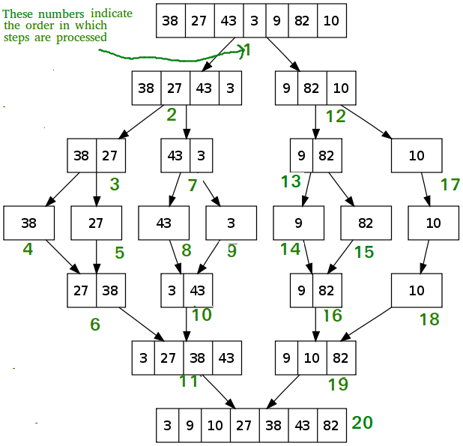
Ref: https://www.geeksforgeeks.org/merge-sort/

Slide 20
Mergesort Algorithm

Slide 21
Analysis of Mergesort
T(1) = 1
T(N) = 2T(N/2) + N
When the size of an input array is equal to 1, the time complexity is constant time.
merge
sort
Input = N
24 | 13 | 26 | 1 | 2 | 27 | 38 | 15
N/2
N/2
24 | 13 | 26 | 1
2 | 27 | 38 | 15

Slide 22
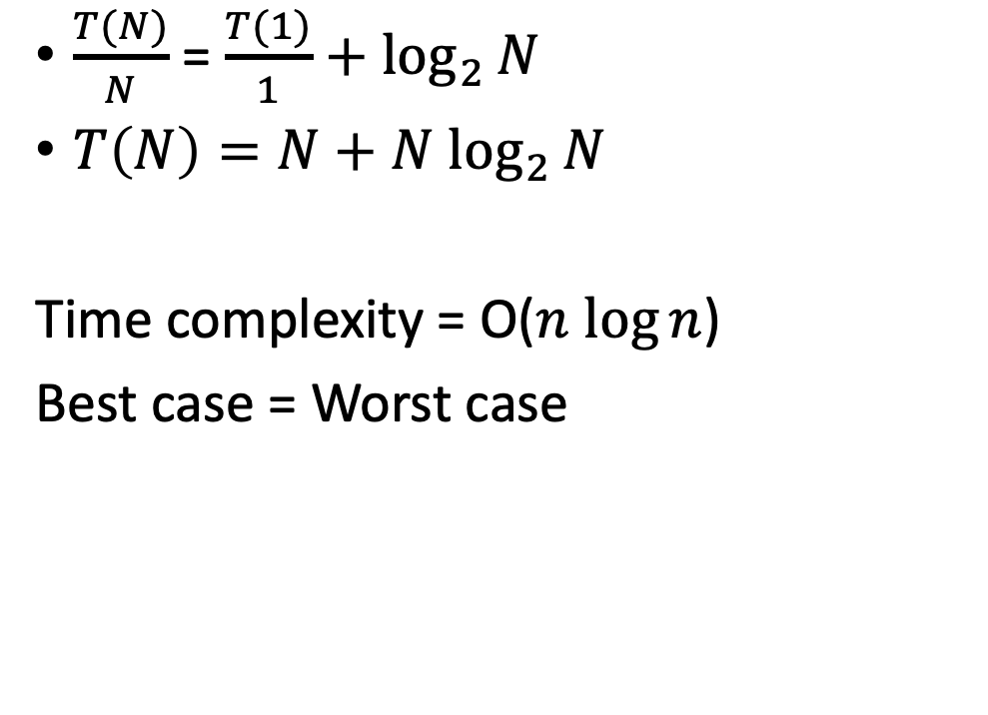

Analysis of Mergesort
T(N) = 2T(N/2) + N
$\frac{T(N)}{N}$ = $\frac{T(N/2)}{N/2}+1$
$\frac{T(N/2)}{N/2}$ = $\frac{T(N/4)}{N/4}+1$
$\frac{T(N/4)}{N/4}$ = $\frac{T(N/8)}{N/8}+1$
$\frac{T(2)}{2}$ = $\frac{T(1)}{1}+1$
$\frac{T(N)}{N}$ = $\frac{T(1)}{1}+\log_{2}{N}$
$T\left(N\right)=N+N$ $\log_{2}{N}$
Time complexity = O($n$ $\log{n}$)
Best case = Worst case

Slide 23
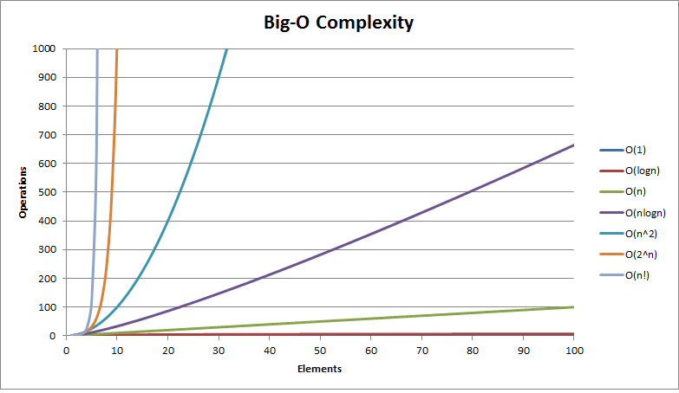
Time Complexity
Time complexity
Input (n)
https://fizalihsan.github.io/technology/algorithms.html

Slide 24
Quicksort
Similar to Mergesort, Divide and Conquer algorithm
pick an element as a pivot
Divide the given input based on the pivot
Pivot can be picked in different ways
Always pick the first element
Always pick the last element
Pick a random element
Pick median

Slide 25
Quicksort
24 | 13 | 26 | 1 | 2 | 27 | 38 | 15
13 | 1 | 2
24 | 26 | 27 | 38
24 | 26 | 27
1
13
24 | 26
24

Slide 26
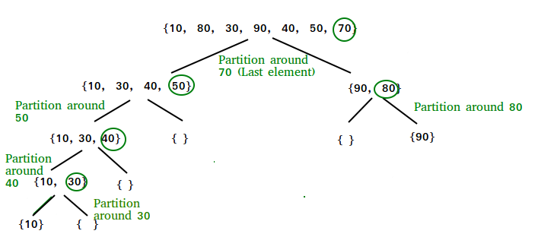
Quicksort
Ref: https://www.geeksforgeeks.org/quick-sort/

Slide 27
Quicksort Algorithm

Slide 28
Exercise
Partition 1: from 0 to 7 Pivot = 15
24 | 13 | 26 | 1 | 2 | 27 | 38 | 15
When j = 0, i = -1 => do nothing
When j =1, updating i = 0 and swap
13 | 24 | 26 | 1 | 2 | 27 | 38 | 15
When j =2, i = 0 => do nothing
When j =3, updating i = 1 and swap
13 | 1 | 26 | 24 | 2 | 27 | 38 | 15
When j =4, updating i = 2 and swap
When j =5, i = 2 => do nothing
When j =6, i = 2 => do nothing
13 | 1 | 2 | 24 | 26 | 27 | 38 | 15
At the end, swap the pivot with i+1
13 | 1 | 2 | 15 | 26 | 27 | 38 | 24
Write down all the steps in the next partitions until the array is sorted

Slide 29
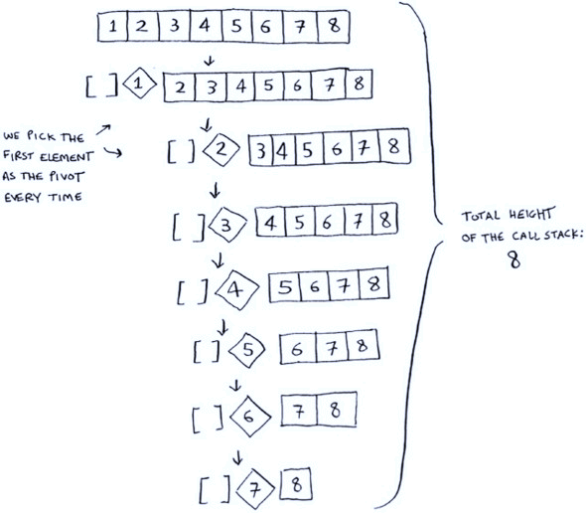
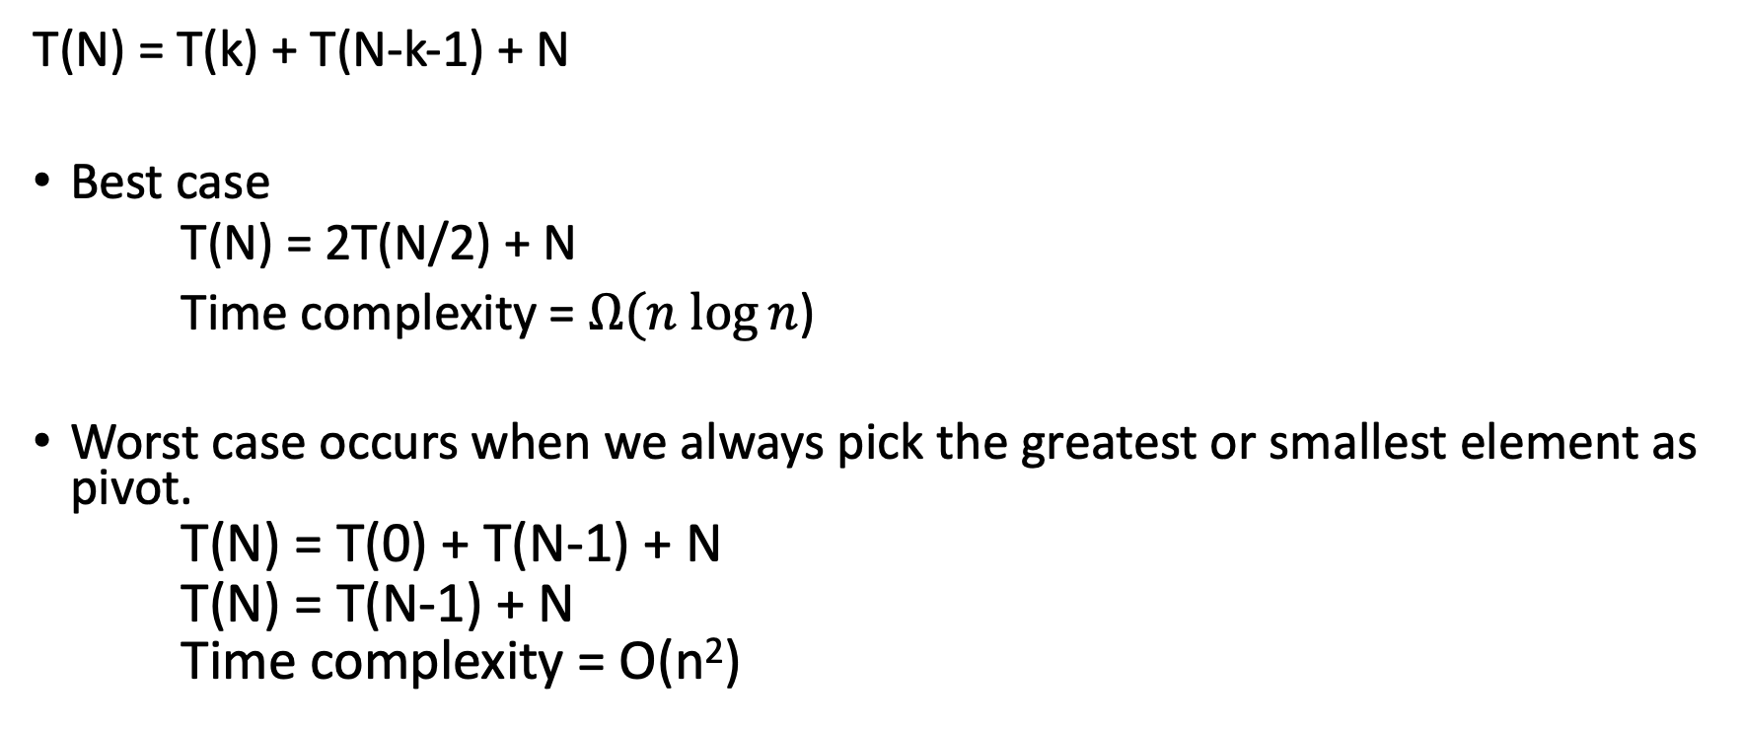
Analysis of Quicksort
Worst case example
T(N) = T(k) + T(N-k-1) + N
Best case
T(N) = 2T(N/2) + N
Time complexity = $Ω(n$ $\log{n}$)
Worst case occurs when we always pick the greatest or smallest element as pivot.
T(N) = T(0) + T(N-1) + N
T(N) = T(N-1) + N
Time complexity = O(n²)

Slide 30
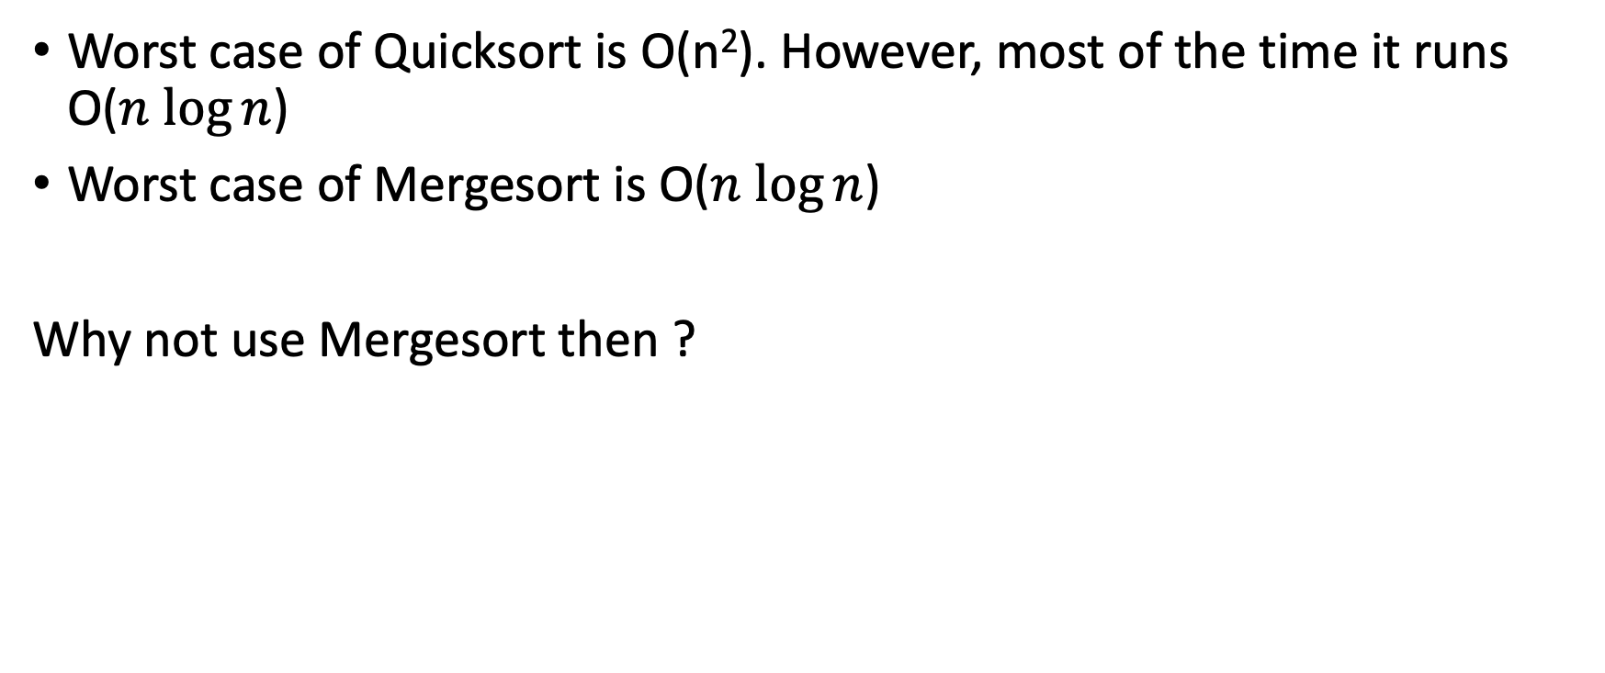
Mergesort vs Quicksort
Worst case of Quicksort is O(n²). However, most of the time it runs O($n$ $\log{n}$)
Worst case of Mergesort is O($n$ $\log{n}$)
Why not use Mergesort then ?

Slide 31
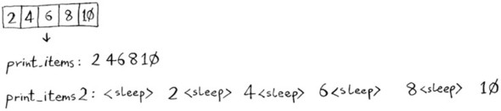
Mergesort vs Quicksort
Which method is faster ?
static void print _item(int arr[]) { int n = arr.length; for (int i = 0; i < n; ++i) System.out.print(arr[i] + " "); System.out.println(); }
static void print _item_2(int arr[]) { int n = arr.length; for (int i = 0; i < n; ++i)
{ System.out.print(arr[i] + " ");
sleep(10)
} System.out.println(); }

Slide 32

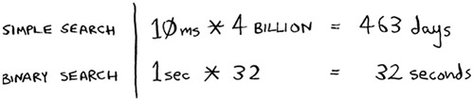

Mergesort vs Quicksort
Two algorithms have different Big O times, the constant doesn’t matter
O(n) O($n$ $\log{n}$)
Let n = 4 billion elements

Slide 33
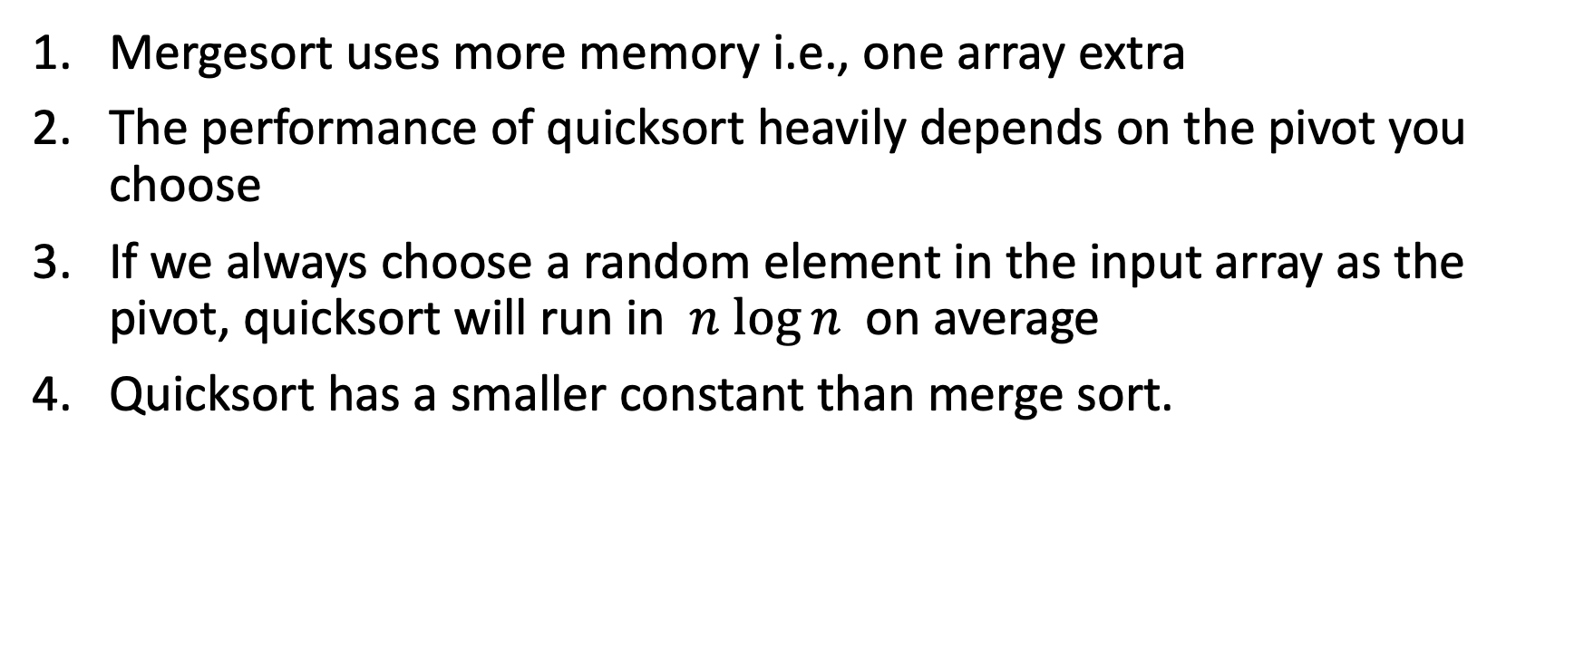
Mergesort vs Quicksort
Mergesort uses more memory i.e., one array extra
The performance of quicksort heavily depends on the pivot you choose
If we always choose a random element in the input array as the pivot, quicksort will run in $n$ $\log{n}$ on average
Quicksort has a smaller constant than merge sort.

Slide 34
Conclusion
Bubble sort
Insertion sort
Mergesort
Quicksort
Selection sort (Home Work)

